Slide 1
Project: A new methodology for comparing performance of prediction algorithms for chaotic dynamical systems
Instructors: Krishna Palem and Robert Cartwright
Project supporters: Devika Subramanian and Nikola Jovanovic
Technical participant: Adam Duracz

Slide 2
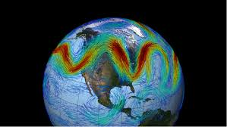
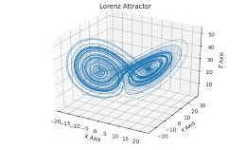
Problem description
Starting with the goal of weather simulation, we first have to tackle some simpler problems that are similar in character
These simpler problems are predicting the behavior of chaotic dynamical systems such as variants of Lorenz and KS systems (benchmark synthetic problems)

Slide 3
Our goals
Predicting chaotic dynamical systems time series behavior using machine learning models such as:
ESN (Echo State Networks),
LSTM (Long-Short Term Memory)
Ensembles of ESNs and LSTMs
Finding the best predictive model for each of the benchmarks by developing a robust methodology for model evaluation and comparison
Understanding why a specific model architecture performs better than others on a particular problem

Slide 4
Some terminology
Model – Implementation of specific machine learning algorithm
Model parameters – Number of input elements and hidden units, training set size, model specific constants, randomization seeds
System state – Set of numerical values (system variables)
There are 8 system variables for Lorenz96 system
IC (Initial condition) – System state the prediction is starting from
MTU (Model Time Unit) – Unit of time describing chaotic system data
For Lorenz96 system, 1 MTU is an interval containing 200 discrete time points
Each time point is represented by one system state which can be used as an initial condition

Slide 5
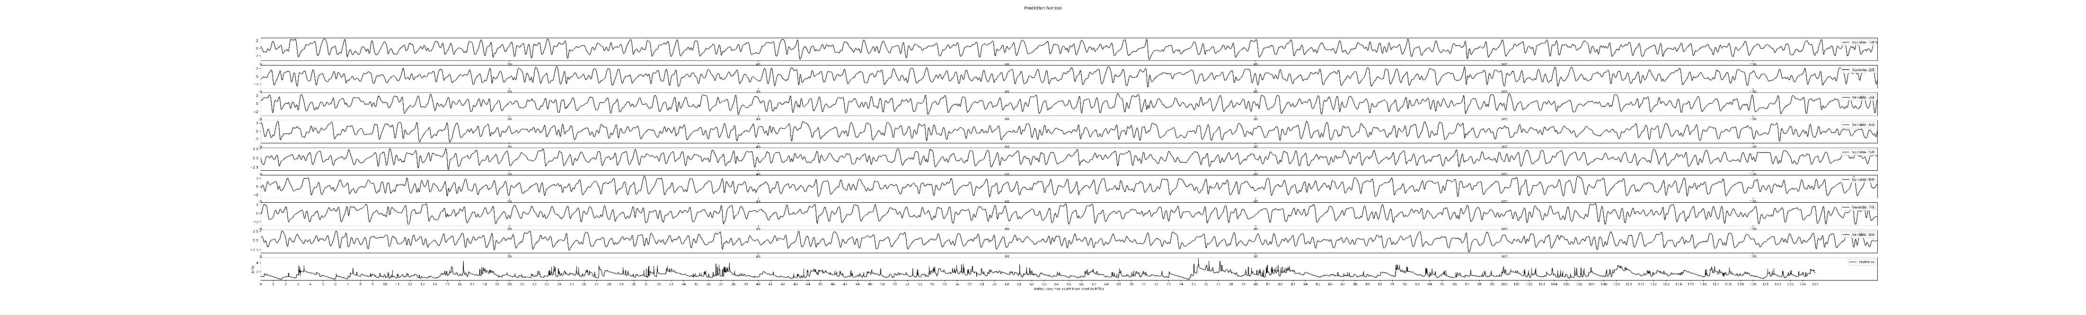
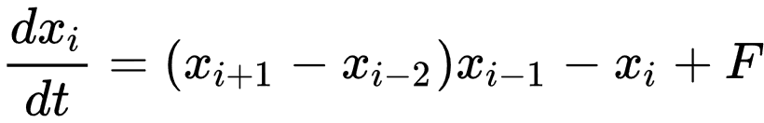
Time-series data taken from Lorenz96 system, containing 8 system variables
For each variable derivative is calculated using the following equation:
Absolute variable values, ranging from -2 to 2
Forcing factor, influencing the complexity of generated data (degree of chaotic behavior)
Propagation through time

Slide 6
Prediction horizon
Prediction horizon: how many predictions of the next time-step produced small enough error compared to the actual data, before the error accumulates
As you can see from this example, two very close IC-s can produce very different result, with no apparent reason
This makes modeling chaotic systems very difficult
Prediction horizon,
when predicting from the green initial condition
Values of 2 variables
Prediction horizon,
when predicting from the orange initial condition

Slide 7
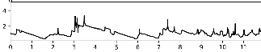
Prediction horizon on consecutive IC-s
Following graph shows prediction horizons, achieved on a set of consecutive initial conditions
Each point on the graph represents the prediction horizon achieved on one of the consecutive initial conditions
Prediction horizon value for each
densely plotted initial condition
E.g. prediction starting from the initial condition at 10.6 MTU from the first one in the set, has produced the prediction horizon of 2.2 MTU
MTU
MTU
Relative time point of each evaluated initial condition

Slide 8
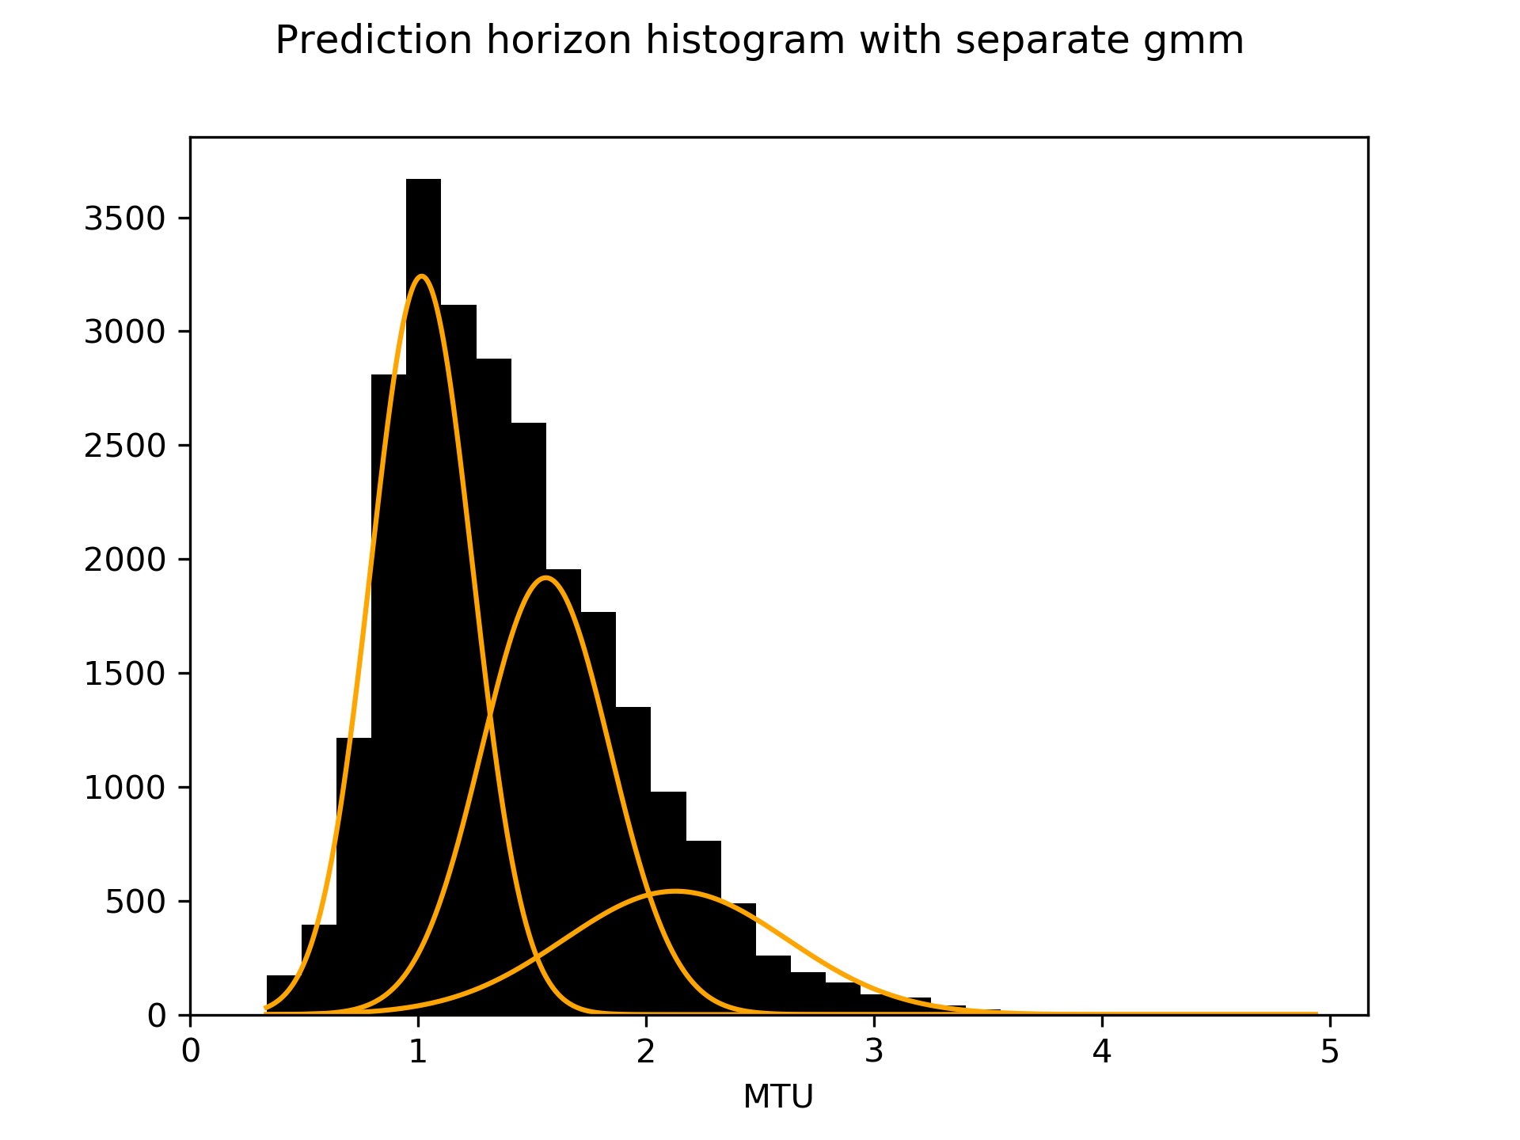
Prediction horizon histogram
Number of initial conditions resulting in a
specific prediction horizon (out of 25000)
Generated histogram does not nicely represent any common distribution, so it is not possible to correctly analyze standard deviations
Problem is solved by dividing the histogram using Gaussian mixtures
Prediction horizon values achieved by evaluated initial conditions

Slide 9
Prediction horizon histogram
Hard initial conditions
(low prediction horizons)
Number of initial conditions resulting in a
specific prediction horizon (out of 25000)
Medium initial conditions
Easy initial conditions
(high prediction horizons)
Prediction horizon values achieved by evaluated initial conditions
E.g. there are around 1000 initial conditions that have produced prediction horizons between 2 and 2.2 MTU

Slide 10
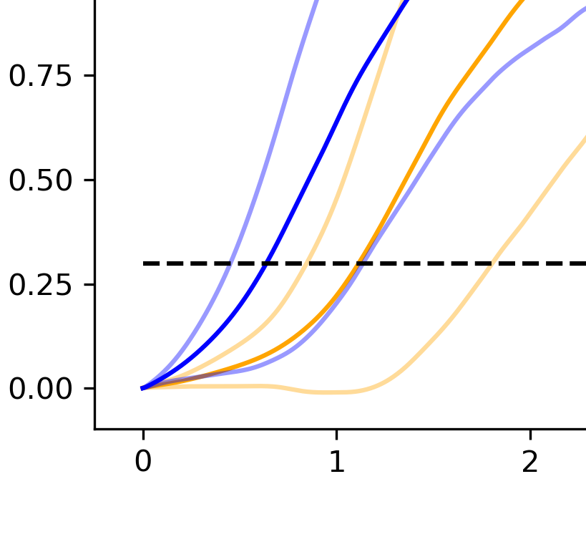
Average error and variation of two models
The average error and its standard deviation is displayed by blue, and another’s by orange line
Although one model seems to cross the prediction horizon threshold sooner, the graph is still ambiguous
Mean squared error and
its standard deviation
Prediction horizon threshold
Number of predicted time steps in MTU

Slide 11
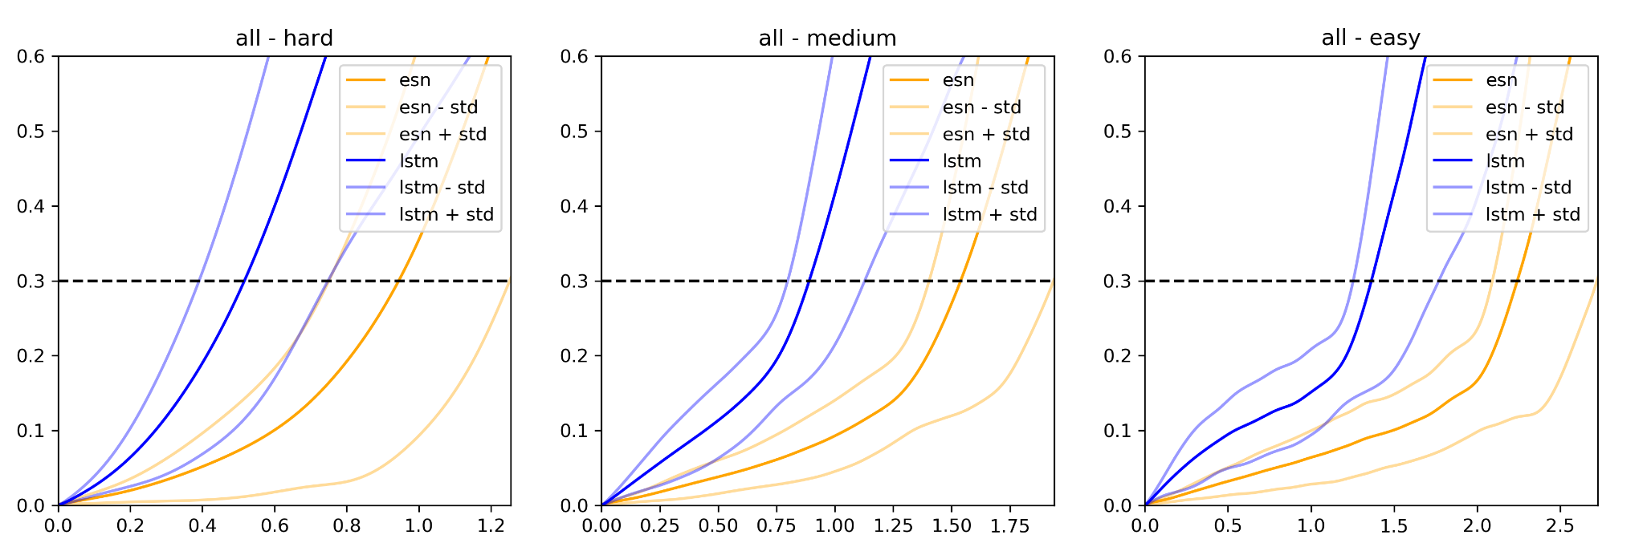
Average error and variation of two models on hard, medium and easy initial conditions
Mean squared error and
its standard deviation
Number of predicted time steps in MTU
E.g. average LSTM error crosses the threshold at 0.5 MTU, while average ESN error crosses the threshold at 1.0 MTU, for initial conditions regarded as hard
Now the ESN model is clearly better

Slide 12

Our benchmark framework
The ML models are tested on predicting chaotic dynamical systems
Each chaotic dynamical system consists of a system of PDEs (Partial Differential Equations) which manifest highly unpredictable behavior in the very short term (tens of time-steps)
Problems that we plan to benchmark:
Lorenz: Lorenz96, Lorenz63, Lorenz40
Kuramoto-Sivashinsky (KS)
One more problem to be named later

Slide 13
Data generation
We produced Python scripts that can be found inside the project folder data_sets and implement basic Runge–Kutta integrator for systems we used:
Lorenz3 and LorenzN
KS
This code can be used as template for implementation of integrators for other systems
This produced data is later used for training and testing models, as well as “ground-truth” data for model validation and comparison

Slide 14
State of our work
We have mostly completed all code implementation steps including training and evaluating models, as well as analyzing model predictions and comparison.
We have focused on Lorenz96 variant of Lorenz system and produced analysis on its data.
To gain enough results and support our methodology, we are aiming to apply our project pipeline to additional chaotic dynamical systems benchmark problems.

Slide 15
The analysis pipeline
Acquire dataset for analyzed chaotic system
Parametrize the code to use desired:
Input data
Model type (ESN, LSTM, ensemble)
Model hyper-parameters (input dimension, model size, …)
Execution hyper-parameters (size of training and testing sets, …)
Train the model and execute prediction analysis on multiple sets of execution hyper-parameters to find the best ones for the model
Execute comparative analysis between different models

Slide 16
Getting started with the project
Familiarize with the code, play with parameters and try to reconstruct existing results
Project file structure:
Folder script – Implementations of ML models used in the project
Folder datasets – Dataset generators and generated chaotic system data
Folder Lorenz_96, 200, 1 – Generated data buffer, avoiding repeated calculation
default_esn.json, default_lstm.json – Auto-loaded model hipper parameters
default_run.json – Prediction hipper parameters (dataset split, …)
pred_horizon_stats.py – Train the model, execute prediction and plot graphs
combine_graphs.py – Loads predictions of two existing trained models, executes comparative analysis and plots graphs

Slide 17
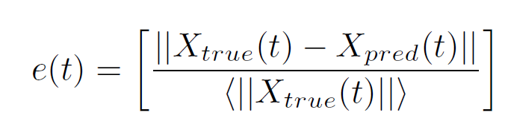
The error metric
The error metric we used to estimate the quality of prediction is an averaged relative L₂ error between the true and predicted trajectories
Following formula represents the average error on each time-step
Average over all predicted
initial conditions (25000)
Average of absolute X_{true} over all predicted
initial conditions (25000) for each time-step t

Slide 18
Your task
Apply the provided code on data representing different chaotic dynamical systems:
Adapt the code parametrization to align with dataset properties (dataset name and input path, input size)
Execute predictions and search for the best model parameters for the given system (using smaller and quicker testing sets), for different models (ESN, LSTM, ensemble)
Execute performance analysis on bigger testing set for each model (this will take the most execution time)
Execute comparative analysis between different models using the same predictions generated during individual performance analysis

Slide 19
Thank you for the attention

